Slide 1
Network Automation with python
By Eric Chou
PyCon TW 2020

Slide 2
“It was the best of times, it was the worse of times, it was the age of wisdom, it was the age of foolishness.”
– Charles Dickens, A Tale of Two Cities

Slide 3


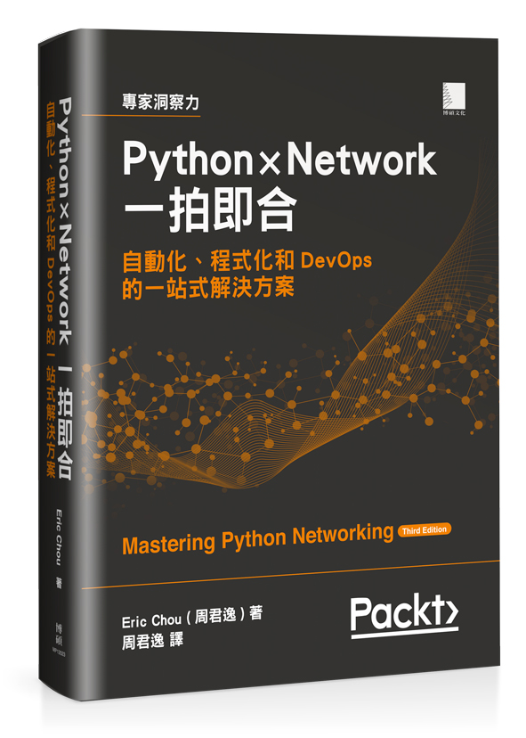

Who am i?
20 years of experience in network engineering
Service provider, equipment vendor, enterprise, cloud provider, etc.
Ex-Amazonian, Ex-Microsoftee
A10 Networks: Security Research Team
Author of ‘Mastering Python Networking’ (Packt Publishing)
Python x Network 一拍即合 (博碩文化)

Slide 4
Topics for today
How did we get here?
Where does Python fit in?
Current State of Network Automation
Recommendations

Slide 5
Traditional networking
Distributed, non-central governing body
Started by US military for distribution of assets
Different forward / return path
Each node needs to be individually managed
Combined control and data plane
Single vendor, closed sourced for a long time
Isolated, domain-specific knowledge (CLI Monkey)

Slide 6
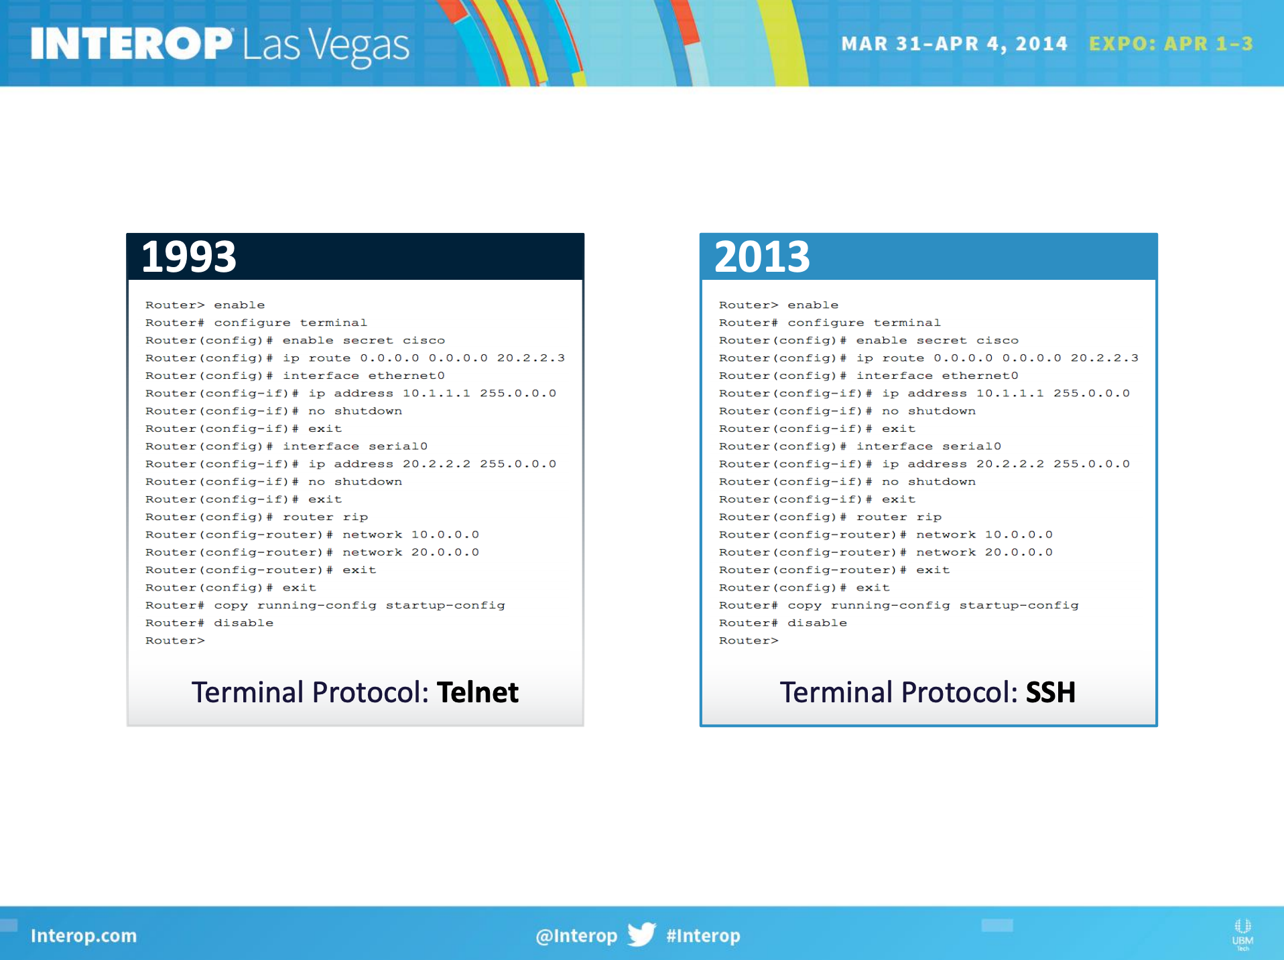
Source: https://bigswitch.com/sites/default/files/presentations/murraydouglasstartuphotseatpanel.pdf

Slide 7
Reasons for change
Software-Defined Networking (Ex. OpenFlow, OpenDaylight, SD-WAN)
Controller-based networking
Network Virtualization (NFV, Ex. Overlay VxLAN)
Hyper-scale datacenters (Amazon AWS, Microsoft Azure, Facebook)
Microsoft SONiC, Facebook FBOSS
Customer demand API (Arista, Juniper, Cisco)

Slide 8

why python
Relatively easy to learn – Network Engineers != Developers
Python beginner-friendly culture
Vendor support：
Onboard Python interpreter (zero-touch provisioning, even-driven scripts, etc.)
Python SDK
Common denominator
Language popularity = large ecosystem, learning resources, etc.

Slide 9
Device level management
Open Source Libraries: Paramiko, NAPALM, Netmiko, Nornir
Cisco: IOS, IOS-XR, IOS-XE
Juniper / Arista / F5
API:
RESTFul API [requests, urllib]
NETCONF (RFC 6241) / RESTCONF (RFC 8040)
XML / JSON [ElementTree, JSON]
YANG Data Model (RFC 7950) [PyYAML]
Onboard management: Python ＋Linux ＋ Container
Vendor provided SDK

Slide 10
#!/usr/bin/env python3
import requests
import json
url='http://172.16.30.53/ins'
switchuser='cisco'
switchpassword='cisco'
myheaders={'content-type':'application/json-rpc'}
payload=[
{
"jsonrpc": "2.0",
"method": "cli",
"params": {
"cmd": "show version",
"version": 1.2
},
"id": 1
}
]
response = requests.post(url,data=json.dumps(payload), headers=myheaders,auth=(switchuser,switchpassword)).json()
print(response['result']['body'])
NX-API Example

Slide 11
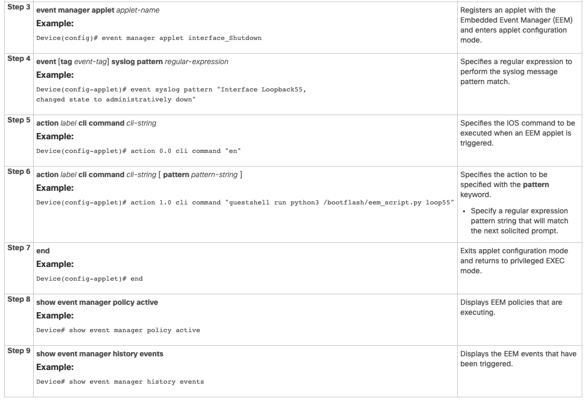
Onboard
Python
Example
Soiurce: https://www.cisco.com/c/en/us/td/docs/ios-xml/ios/prog/configuration/166/b_166_programmability_cg/eem_python_module.html

Slide 12
Controller-based management
Cisco:
ACI, NSO, SD-WAN (Viptela), Meraki (cloud-based controller)
VMWare (Nicera):
NSX (CCP for NSX-T Data Centers)
Big Switch Network (Arista Networks):
Big Cloud Fabric / Big Monitoring Fabirc
OpenDaylight

Slide 13
Cisco meraki example
# Step 1. Retrieves an organization's ID from Meraki dashboard API based on organization name
def get_org_id(url, headers, name):
org_list = requests.get(url + '/api/v0/organizations', headers=headers).json()
for org in org_list:
if org['name'] == name:
return org['id']
# Step 2. retrieves organization inventory based on ID
def get_inventory(url, headers, org_id):
inventory_list = requests.get(url + '/api/v0/organizations/' + org_id + '/inventory',
headers=headers).json()
return inventory_list
myheaders={'X-Cisco-Meraki-API-Key': ‘<my api key>'}
url = 'https://dashboard.meraki.com'
org_name = 'DevNet Sandbox'
org_id = get_org_id(url, myheaders, org_name)
inventory_list = get_inventory(url, myheaders, org_id)
# Step 3. print out the inventory list and write it to a file named inventory_list.txt with
# one item per line
pprint.pprint(inventory_list)

Slide 14

Source: https://en.wikipedia.org/wiki/Levi%27s_Stadium
Edge compute
Reference: https://www.cisco.com/c/en/us/solutions/industries/sports-entertainment/connected-stadium.html

Slide 15
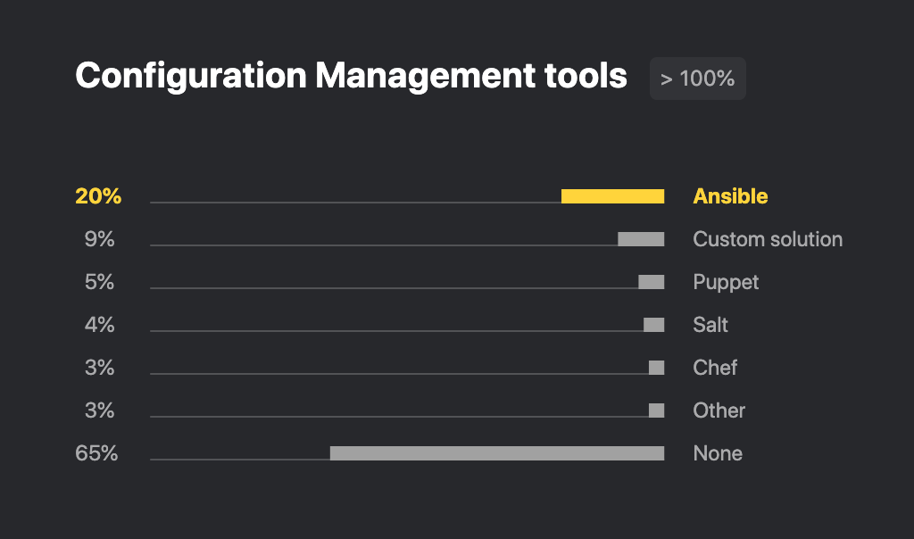
Network Automation frameworks
Ansible (Python-based, non-agent, idempotent, declaritive)
Others: Salt, Puppet, Chef
Supported by most vendors: Cisco NSO / ACI / Viptella, Juniper, Arista etc.
Uses YAML, Jinja2, etc.
Source: https://www.jetbrains.com/lp/python-developers-survey-2019/

Slide 16
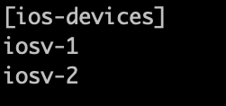
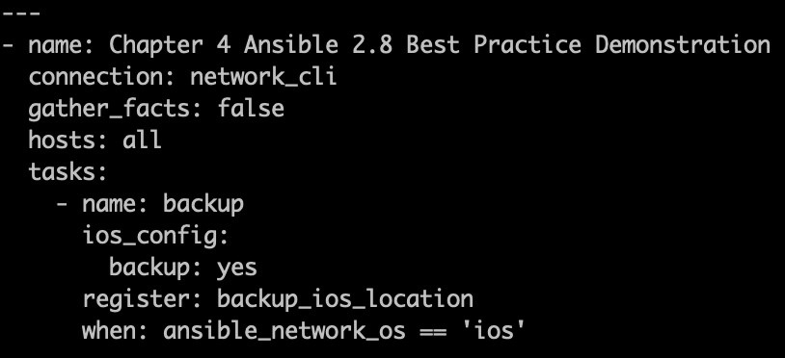
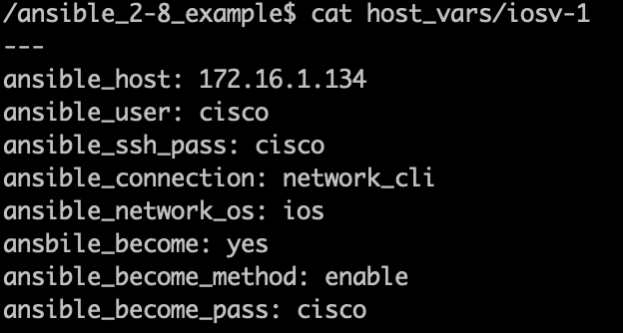
Ansible Example
1. Hosts
3. Playbook
2. Host Variables

Slide 17
Demonstration
GitHub Repository:
https://github.com/ericchou1/pycontw2020-network-automation-with-python

Slide 18
Additional resources
Cisco DevNet: https://developer.cisco.com/
Juniper: https://www.juniper.net/us/en/solutions/automation/
Arista: https://www.arista.com/en/products/network-data-center-automation
Ansible for Network Automation:
https://docs.ansible.com/ansible/latest/network/index.html
YANG Model: http://www.yang-central.org/
Python x Network 一拍即合(https://www.tenlong.com.tw/products/9789864345021?list_name=b-r30-zh_tw)

Slide 19
Recommendations
Start with device level management
Lab with EVE-NG, GNS3, VIRL, DevNet
Controller-based solution if applicable
Prefer open source projects over vendor-supplied SDK
Ansible
Nornir

Slide 20
“It was the best of times, it was the worse of times, it was the age of wisdom, it was the age of foolishness.”
– Charles Dickens, A Tale of Two Cities
Notes:
回到我們一開始所說狄更斯在雙城記中的語錄，他跟網路管理有什麼關聯呢？
我覺得現在網路管理，就像在這個語錄中形容的一個非常快速改變、世代交接的階段，有一些混亂、但也有很多的機會，關聯就是在我犯過ㄧ些錯和走了一些冤妄路後我覺得 Python 是一個適合突破現狀，集合各方人馬的工具。

Slide 21
Twitter: @ericchou
LinkedIn: https://www.linkedin.com/in/choueric/

Slide 22
The end

